Slide 1
Network Programming Lab

Slide 2
Computer Network
A computer network is a set of computers sharing resources located on or provided by network nodes.
The computers use common communication protocols over digital interconnections to communicate with each other.

Slide 3
What Is Network Programming?
Network programming is the act of using computer code to write programs or processes that can communicate with other programs or processes across a network. Programmers use various programming languages, code libraries, and protocols to do the work.

Slide 4
Main types of networks to program
Network programming is a rapidly evolving discipline. However, engineers programming networks still need traditional skills and other knowledge. That knowledge includes understanding the main types of networks that many of today's businesses use, such as the following:
LAN.
MAN.
WAN.
WLAN.
VPN.

Slide 5
LAN (Local Area Network)
A LAN is a collection of devices connected in one location, such as a building, an office, or a home. A LAN can be small or large, ranging from a home network with one user to an enterprise network with thousands of users and devices.

Slide 6
MAN (Metropolitan-Area Network)
A MAN is a network that may serve a town, city, university campus, or a small geographic region. A MAN is typically larger than a LAN.

Slide 7
WAN (Wide-Area Network)
In its simplest form, a WAN is a collection of LANs or other networks that communicate with one another. A WAN is essentially a network of networks. The internet is the world's largest WAN.

Slide 8
WLAN (Wireless LAN)
A WLAN implements a flexible data communication system, frequently augmenting rather than replacing a wired LAN within a building or campus. WLANs use radio frequency to transmit and receive data over the air, reducing the need for wired connections.

Slide 9
VPN (Virtual Private Network)
A VPN is an encrypted internet connection between a user device and a network. The encrypted connection helps to ensure that sensitive data is transmitted safely. It prevents unauthorized people from accessing the traffic.

Slide 10
Goals for this Lab
Installation of python 3 on your machine.
Exploring pythons core networking libraries.
What is IPv4 and machine name.

Slide 11
Python Installation
For Windows users:
We need to install python 3 which we can do by going to https://www.python.org/downloads/
Download the file.
Add path.
Open cmd and type python to check if the installation is properly done.
For Linux and MacOs users python 3 is already installed and you can simply open it by typing python3 in the terminal

Slide 12
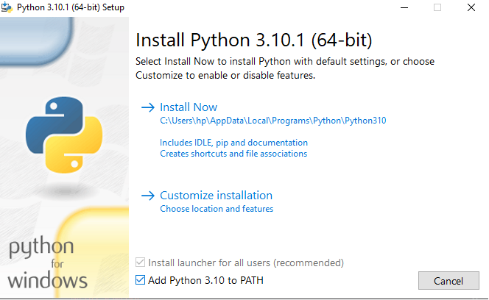

Slide 13
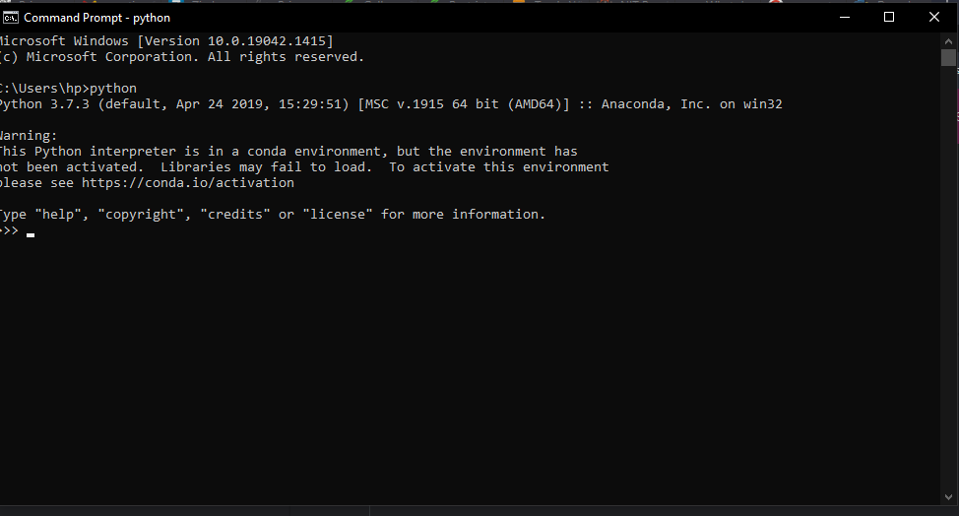

Slide 14
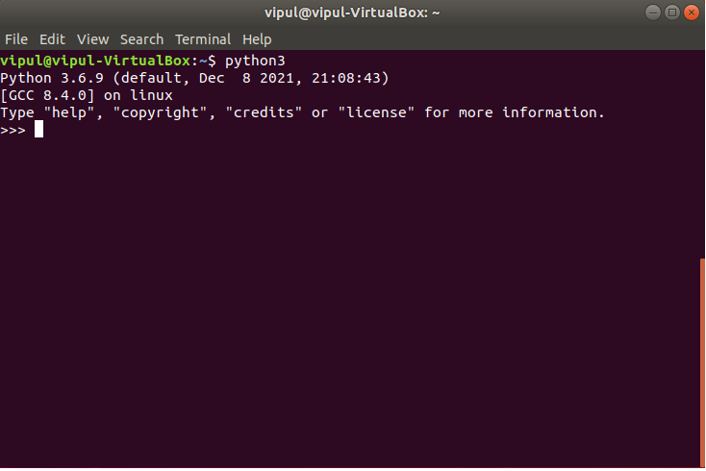

Slide 15
Python Basics
Print
Prints a string into the console.
Input
Prints a string into the console, and asks the user for a string input.
Comments
Adding a # symbol in font of text lets you make comments on a line of code. The computer will ignore your comments.
print("Hello World")
input("What's your name")
#This is a comment
print("This is code")

Slide 16
Contd.
Variables
A variable give a name to a piece of data. Like a box with a label, it tells you what's inside the box.
Data Types
String Concatenation
my_name = “Manas"
my_age = 19
my_interger = 35
my_float = 3.14159
my_string = “Hello”
"Hello" + “User"
#becomes "HelloUser"

Slide 17
Contd.
F String.
You can insert a variable into a string using f-strings. The syntax is simple, just insert the variable in-between a set of curly braces {}.
Converting Data Types
days = 365
print(f"There are {days} in a year")
n = 354
new_n = float(n)
print(new_n) #result 354.0

Slide 18
Cond.
Checking Data Types.
Arithmetic Operators.
n = 3.14159
type(n) #result float
3+2 #Add
4-1 #Subtract
2*3 #Multiply
5/2 #Divide
5**2 #Exponent

Slide 19
Machine Name and IPv4
The name of your machine is called its machine name or hostname.
IPv4 stands for Internet Protocol version 4.
It is the underlying technology that makes it possible for us to connect our devices to the web.
Whenever a device accesses the Internet, it is assigned a unique, numerical IP address such as 99.48.227.227.
To send data from one computer to another through the web, a data packet must be transferred across the network containing the IP addresses of both devices.

Slide 20
Library Used
Socket in the primary library.
Socket library is used to lookup details of the network including hostname and ip address.
To use it we type “import socket”
Use help() to find out the documentation of any installed python library

Slide 21
Problem 1
WAP for printing your machine’s name and IPv4 address?
Hint use the socket library to find the hostname and address.
Use Notepad to write your script or any code editor.
Save your file as “firstprogram.py”
To run your file write python firstprogram.py in the cmd.
For Linux use python3 firstprogram.py.

